Slide 1

Predicting Diabetes: A Comparative Analysis of Machine Learning Algorithms
INFO-H 515 Final Project Gast, Chris Ghoradkar, Priyesh Khalil, Hussein Raut, Shivani
May 4, 2023

Slide 2



Agenda
INTRODUCTION
METHODOLOGY
RESULTS
EVALUATION
DISCUSSION

Slide 3
Timeline
Step 1
Understanding the Data
Step 2
Perform Exploratory Data Analysis
Step 3
Perform Data Cleaning and Data Balancing
Step 4
Step 4
Perform hyper-parameter tuning and cross validation
Train different classification models

Slide 4

INTRODUCTION

Slide 5
Prediabetes and Diabetes
A growing problem
Estimated that 451 million adults were diagnosed with diabetes worldwide in 2017¹
By 2045, it is expected that 693 million adults will have been diagnosed with diabetes¹
Diabetes is one of the most prevalent non-communicable diseases worldwide
The prediabetes/diabetes link
According to an American Diabetes Association (ADA) panel, up to 70% of individuals with prediabetes will eventually develop diabetes²
1: Cho NH, Shaw JE, Karuranga S, Huang Y, da Rocha Fernandes JD, Ohlrogge AW, et al. IDF Diabetes Atlas: Global estimates of diabetes prevalence for 2017 and projections for 2045. Diabetes Research and Clinical Practice. 2018 Apr 1;138:271–81.
2: Tabák AG, Herder C, Rathmann W, Brunner EJ, Kivimäki M. Prediabetes: a high-risk state for diabetes development. Lancet. 2012 Jun 16;379(9833):2279-90. doi: 10.1016/S0140-6736(12)60283-9. Epub 2012 Jun 9. PMID: 22683128; PMCID: PMC3891203.

Slide 6
Diabetes
Nearly 1/3rd of patients with diabetes are unaware of their status due to presentation that is commonly asymptomatic¹
High glucose levels from diabetes can result in:
Cardiovascular disease
Blindness
Renal failure
Early and accurate identification can minimize disease progression and complications
1: Banday MZ, Sameer AS, Nissar S. Pathophysiology of diabetes: An overview. Avicenna J Med. 2020 Oct 13;10(4):174–88.

Slide 7
Studies and Literature
The National Health and Nutrition database trained and tested five different models for predicting diabetes and were able to identify diabetes with up to 82.1% accuracy¹
A study of diabetes in the Pima Indians was analyzed using several methods, including Naïve Bayes, a random forest, and a J48 decision tree. The random forest model achieved 79.57% accuracy and the Naïve Bayes was accurate 79.13% of the time on a 3-factor data subset²
Çalişir and Doğantekin used a multi-stage approach, with a Linear Discriminant Analysis (LDA) method for feature extraction feeding into a classification stage using Morlet Wavelet Support Vector Machine (MWSVM). This model achieved a classification accuracy of 89.74%³
These are just of a few of the many studies using supervised learning to classify diabetes patients
1: Qin Y, Wu J, Xiao W, Wang K, Huang A, Liu B, et al. Machine Learning Models for Data-Driven Prediction of Diabetes by Lifestyle Type. Int J Environ Res Public Health. 2022 Nov 15;19(22):15027
2: Chang V, Bailey J, Xu QA, Sun Z. Pima Indians diabetes mellitus classification based on machine learning (ML) algorithms. Neural Comput Appl. 2022 Mar 24;1–17 3: Çalişir D, Doğantekin E. An automatic diabetes diagnosis system based on LDA-Wavelet Support Vector Machine Classifier. Expert Systems with Applications. 2011 Jul 1;38(7):8311–5.

Slide 8

The way to get started is to quit talking and begin doing.
Walt Disney

Slide 9




Methodology

Slide 10
Data: The BRFSS
The 2015 Behavioral Risk Factor Surveillance System (BRFSS) is a random digit dialed combined land line and mobile phone health survey conducted by the US Center for Disease Control (CDC)¹
253,680 survey responses
Covers all 50 US states, as well as the District of Columbia, Guam, and Puerto Rico
The 2015 BRFSS focuses on collecting self-reported information on health risk behaviors, and the data includes 22 variables covering:
Demographic information
Lifestyle and dietary habits
Prevalence of chronic conditions
Use of preventative healthcare services
1: Rolle-Lake L, Robbins E. Behavioral Risk Factor Surveillance System. In: StatPearls [Internet]. Treasure Island (FL): StatPearls Publishing; 2023 [cited 2023 Apr 18]. Available from: http://www.ncbi.nlm.nih.gov/books/NBK553031/

Slide 11
Initial Data Processing
In order to limit our scope to a binary classification problem we recoded the Diabetes variable from a 3 level factor (0 = no diabetes, 1 = prediabetes, 2 = diabetes) to a binary format (0 = no diabetes, 1 = prediabetes or diabetes)
All categorical values were converted to factors
All numerical variables were treated as continuous
We confirmed no missing values were present, and removed duplicate instances, which reduced the dataset to 229,712 responses

Slide 12
Data Exploration
Exploratory data analysis was conducted on variables using frequencies, percentages, means, medians, and visualizations.
Correlation coefficients were computed to understand relationships between variables.
Class imbalance was noted for diabetes, with the minority class only represented in 17% of samples.
A random sample of 100,000 instances was used for model training and test.
The sample was split into a 70,000-sample training set and a 30,000-sample testing set
Random over-sampling was chosen to ensure even representation of both diabetes categories. The ROSE package in R was used for this oversampling

Slide 13
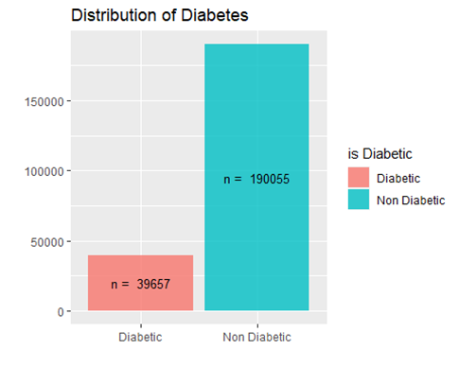
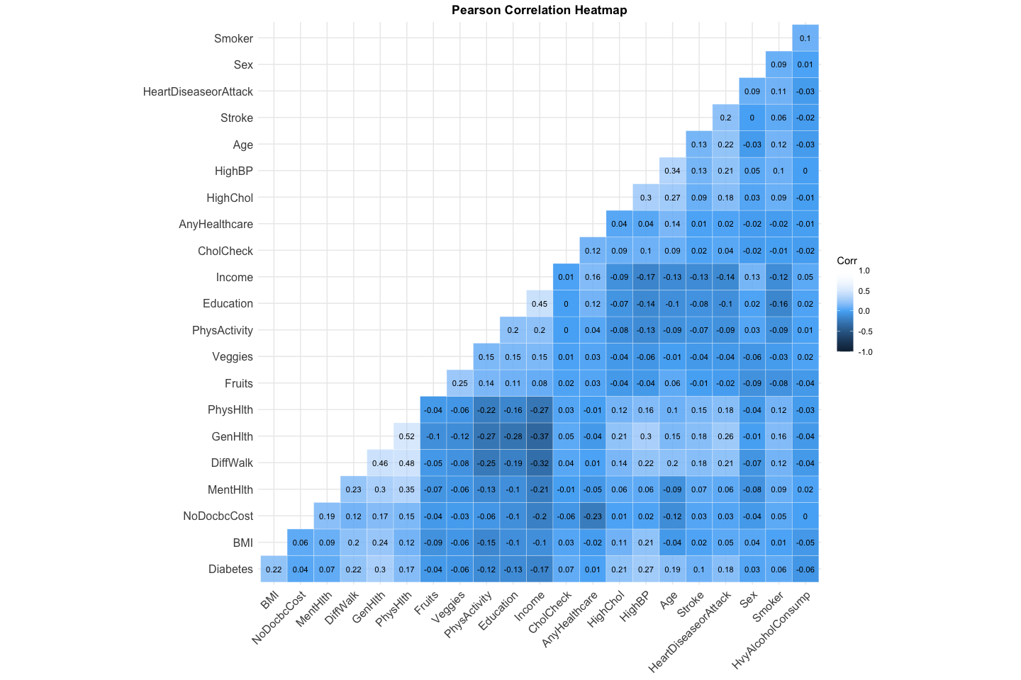
The data is imbalanced with 17% of the respondents having diabetics. Measures to be taken to balance the dataset. Techniques like Sampling methods, SMOTE, ROSE package over sampling or under sampling can be used.
After calculating the correlation matrix, variables that have high correlation with Diabetes: BMI, DiffWalk, PhysHlth, HighChol, HighBP, and Age, Education, GenHlth, and Income

Slide 14
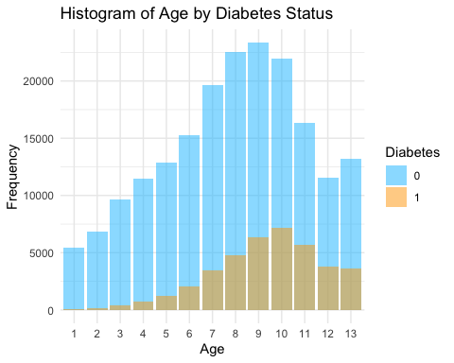
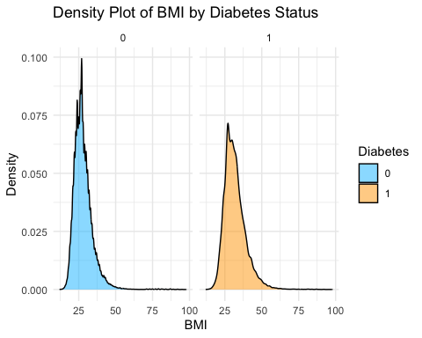
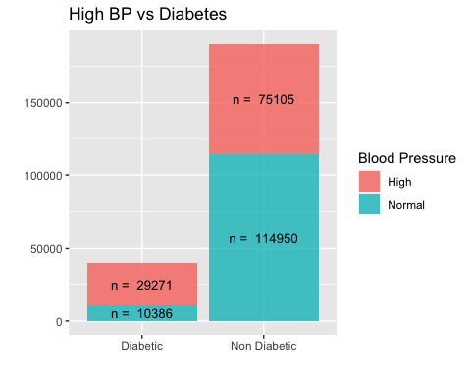
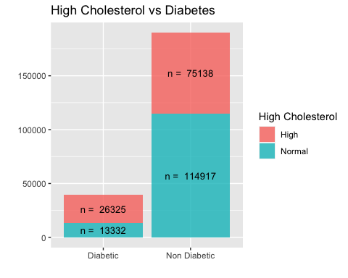

Slide 15
Special Note on EDA
Rose
The study noted a class imbalance for diabetes where the minority class was represented in only 17% of the samples. This can lead to biased model predictions favoring the majority class. Under-sampling and over-sampling techniques were considered as solutions, and random over-sampling was chosen to ensure both categories were evenly represented.
We chose to employ random over-sampling as provided by the ROSE package in R to ensure both categories for diabetes are evenly represented. ROSE uses a smoothed bootstrap technique to generate artificial samples of both majority and minority classes, resulting in a dataset with a balanced target class. After applying ROSE, we obtained a balanced dataset.

Slide 16
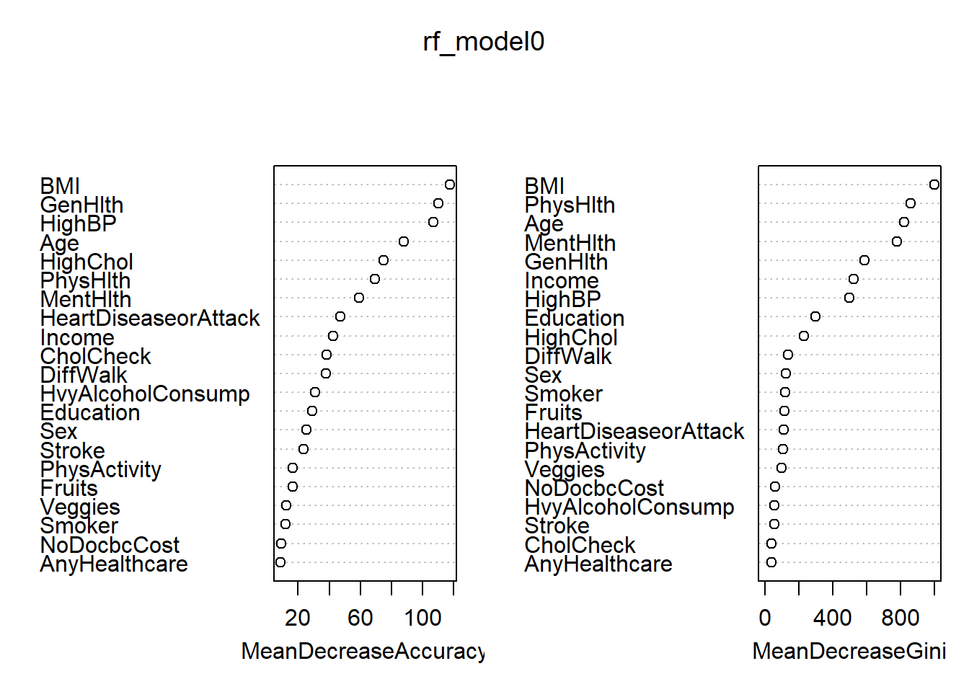
Variable Selection
The study identified important features for predicting diabetes, including BMI, Diffwalk, Physhlth, HighChol, HighBP, Age, Education, GenHlth, and Income.
A Random Forest Classification model was used to identify the most important features, and the Out-of-Bag (OOB) error rate was 22.33%.
The selected potential predictors for the models included BMI, PhysHlth, MentHlth, Age, GenHlth, Income, HighBP, Education, DiffWalk, and HighChol.

Slide 17
Analysis
Models
A variety of classification models were considered to predict diabetes for each respondent.
Cross-validation was performed and the outcomes for each classification model were compared.
Logistic Regression,
Linear Discriminant Analysis (LDA)
Naïve Bayes
Random Forest
K-Nearest Neighbors(KNN)
Support Vector Machines (SVM)

Slide 18

Discussion

Slide 19
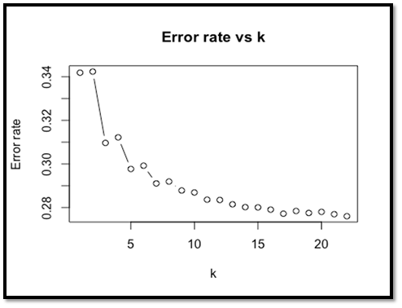
K Nearest Neighbors
A KNN model was constructed, and a variety of K-values from 1 to 22 were evaluated to find the K-value with the highest proportion of correctly classified instances within the training set
Optimization of K-value based on training set accuracy was performed, and an optimal K-value of 19 was selected
5-fold cross-validation was performed to assess the generalization performance of the KNN model
The final model was evaluated against the test set and resulted in 73.08% accuracy, 76.55% sensitivity, 71.71% precision, and 69.59% specificity

Slide 20
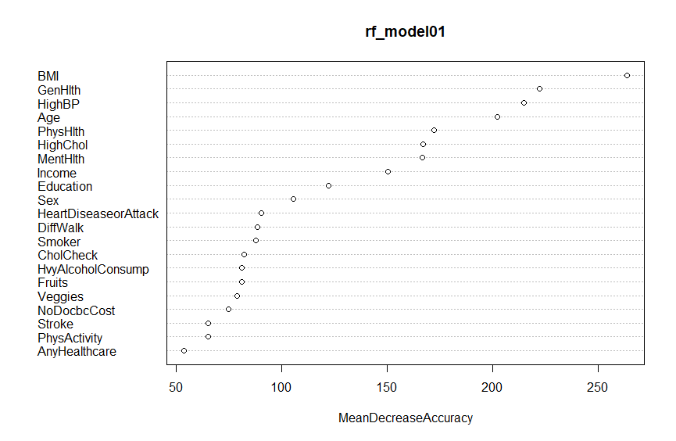
Random Forest/Tree Models
Several types of tree and forest models, including a greedy decision tree, a random forest, bagging, and a tuned random forest were investigated
A Random Forest model using all predictors performed the best, with a test set accuracy of 77.56%, sensitivity of 81.55%, and specificity of 73.48%
This model identified BMI, PhysHlth, MentHlth, Age, GenHlth, Income, and HighBP as important predictors of the presence of diabetes
A grid of parameters for the random forest model was created with different values for mtry, nodesize, and ntree, and a forest was run for each combination and the model with the lowest OOB error. This tuning did not outperform the initial model with the default values of mtry and nodesize and an ntree = 1,000

Slide 21
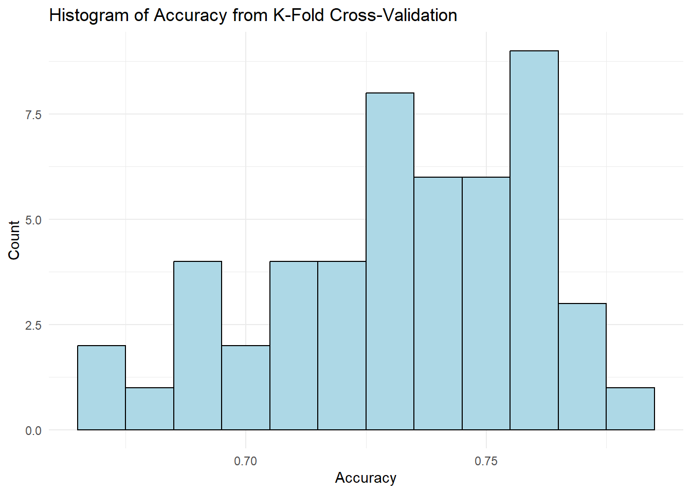
Logistic Regression
Logistic Regression model was used to predict diabetes or prediabetes.
9 out of 21 feature variables were used, selected based on significance and variable importance.
Fitted variables: BMI, PhysHlth, MentHlth, Age, GenHlth, Income, HighBP, Education, and HighChol.
Test data results: accuracy - 72.52%, sensitivity - 75.42%, specificity - 69.57%, precision - 71.64%, negative predictive value - 73.53%.
K-fold cross-validation (k=10) was used to assess model performance and reliability using the 'caret' package in R.
Cross-validated model achieved an average accuracy of 73.25%, which is close to the test data results.

Slide 22
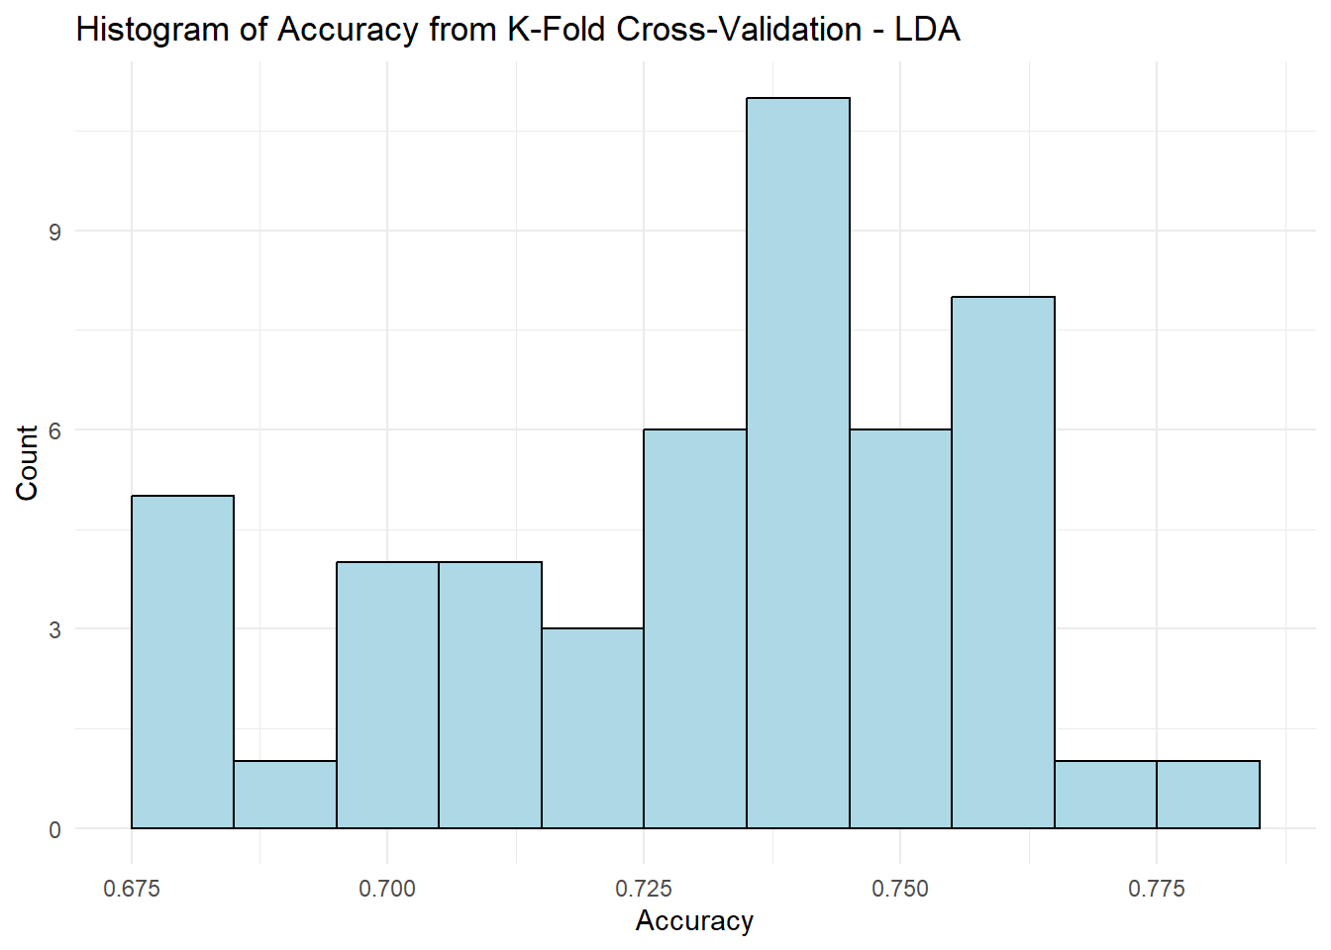
LDA
Linear Discriminant Analysis (LDA) was explored as an alternative machine learning algorithm to predict diabetes using 9 predictor variables.
The LDA model yielded an accuracy of 73.71%, sensitivity of 68.72%, specificity of 75.87%, precision of 73.65%, and negative predictive value of 71.20%.
K-fold cross-validation (k=10) was applied using the same package employed for logistic regression.
The average accuracy of the LDA model after k-fold cross-validation was 72.17%.

Slide 23
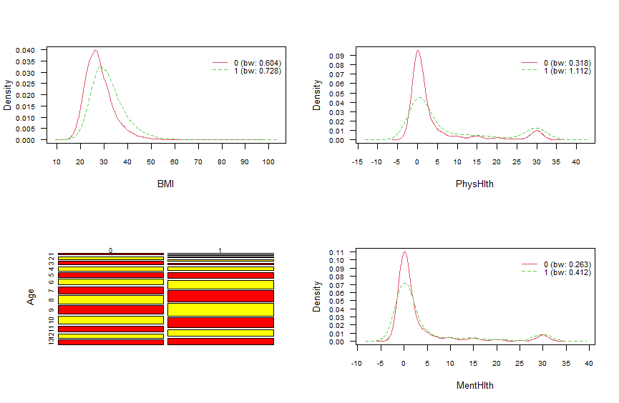
Naïve Bayes
Naïve Bayes is a classification algorithm which assumes that all predictors are independent, which may not always be true in reality.
Despite this, it can still produce useful results.
The algorithm was trained using variables like BMI, PhysHlth, Age, MentHlth, GenHlth, Income, HighBP, Education, HighChol.
The trained model achieved an accuracy of 73.39%, a precision of 73.36%, a sensitivity of 74.22%, and a specificity of 72.54%.

Slide 24
SVM
Support Vector Machines (SVM) is a powerful and flexible machine learning algorithm.
It works well for both linearly separable and non-linearly separable data, making it suitable for a wide range of problems.
The 'e1071' library was used to train the SVM model on the training data.
The radial basis function kernel was used for training the SVM model.
The cost and gamma parameters were set to 1 and 0.1, respectively.
The SVM model achieved an accuracy of 72.74%, sensitivity (true positive rate) of 67.87%, specificity (true negative rate) of 77.51%, precision (positive predictive value) of 74.76% and negative predictive value of 71.09% was achieved.

Slide 25
Results and Evaluation
 | Accuracy | Sensitivity | Specificity
Logistic Regression | 72.52% | 75.42% | 69.57%
LDA | 72.33% | 68.72% | 75.87%
Naïve Bayes | 73.39% | 74.22% | 72.54%
KNN | 73.08% | 76.55% | 69.59%
Random Forest | 77.56% | 81.55% | 73.48%
SVM | 72.74% | 67.87% | 77.51%
BMI, PhysHlth, MentHlth, Age, GenHlth, Income, and HighBP were identified as important predictors of the presence of diabetes by the model.
These predictors were consistent with those used in other models.
1: Qin Y, Wu J, Xiao W, Wang K, Huang A, Liu B, et al. Machine Learning Models for Data-Driven Prediction of Diabetes by Lifestyle Type. Int J Environ Res Public Health. 2022 Nov 15;19(22):15027
2: Chang V, Bailey J, Xu QA, Sun Z. Pima Indians diabetes mellitus classification based on machine learning (ML) algorithms. Neural Comput Appl. 2022 Mar 24;1–17

Slide 26
Random forest model performed the best overall among the classification models explored.
The model had an accuracy of 77.56%, sensitivity of 81.55%, and specificity of 73.48%.
Previous research also has shown that ensemble methods, such as random forest, are effective in handling complex, high-dimensional data.

Slide 27


Thank You

